Slide 1
WELCOME TO CLASS!
Mrs. Karen K. Lawler-Kelley, Ed.S

Slide 2
What should I sign up for?
Remind- All students
Quia- World History
AP Classroom- APHG only
Anything we use not connected to GC

Slide 3
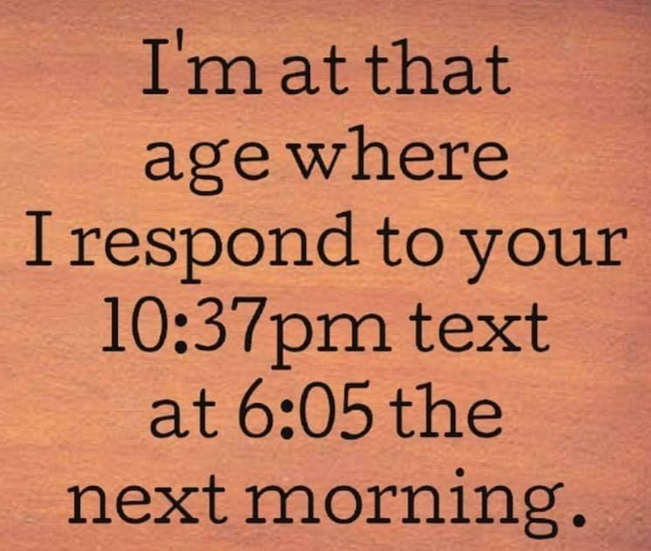
How should I get in touch with Mrs. L?
By Remind before 5 pm
I DO NOT check email once I leave school
I will not respond after 5 pm

Slide 4
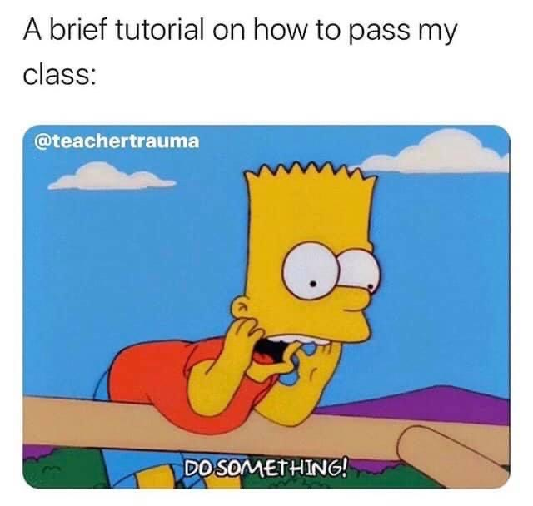
How do I prepare for class?

Slide 5
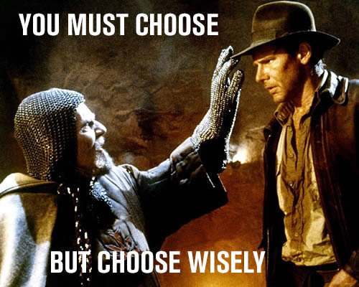

Slide 6
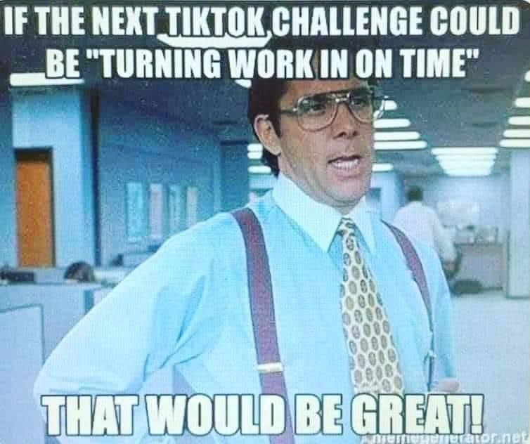
Is late work accepted?
Use paper or phone calendars to keep up when you are given an assignment and when it is due.
Late Work Policy
1 day- 10 points 2 days- 20 points 3 days- 30 points 4 days- will not take it
Once it is graded and recorded,
I will no longer accept any work for that assignment.
Once the assignment is graded and passed back to the students
NO ONE will be allowed to do the assignment and turn it in.
THERE IS NO TURNING WORK IN AT THE END OF THE SEMESTER.

Slide 7
LET ME REPEAT THIS.
This is NOT Middle School
There is NO turning work in a the end of the semester.
You have FOUR DAYS After the Due date. Period.

Slide 8
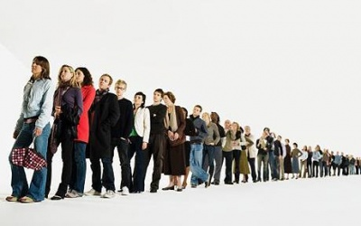
The bell
does not release you.
I Do
NOT DOING this Middle School thing...
Lining
Up
At
The
Door.

Slide 9
Do you curve grades?

Slide 10
What happens if I get caught CHEATING?
A grade of zero and no further opportunity for that assignment will be given.
Cheating includes the giving and receiving of information.
All students involved will receive a zero.
Cheating also includes plagiarizing from another source including the Internet.
NO using A.I. for anything unless it is part of the lesson.

Slide 11
What if I need Make Up Work?
Students absent on the day of a test or quiz must schedule an appointment with me the day they return.
Failure to makeup an assignment or assessment will result in a grade of zero.
It is the student’s responsibility to find out what was missed in class on the day or days absent.

Slide 12
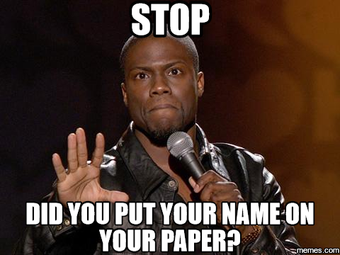
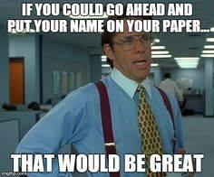
PUT.
YOUR. NAME. ON.
YOUR. PAPER.

Slide 13
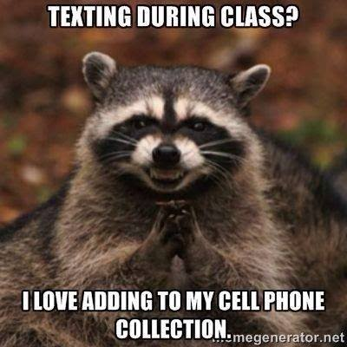
Can we use our phone or smart watches?
Phones will be placed in the pocket caddy at the front of class when you come into class. NON- NEGOTIABLE
Apple watches go in your purse or backpack
Your job is to get an education, not spend your day on TikTok
IF you place a “dummy” phone in the caddy, your actual phone will be taken and both you and your phones will go to the front office.
NO Hoods
on
NO AIR PODS

Slide 14
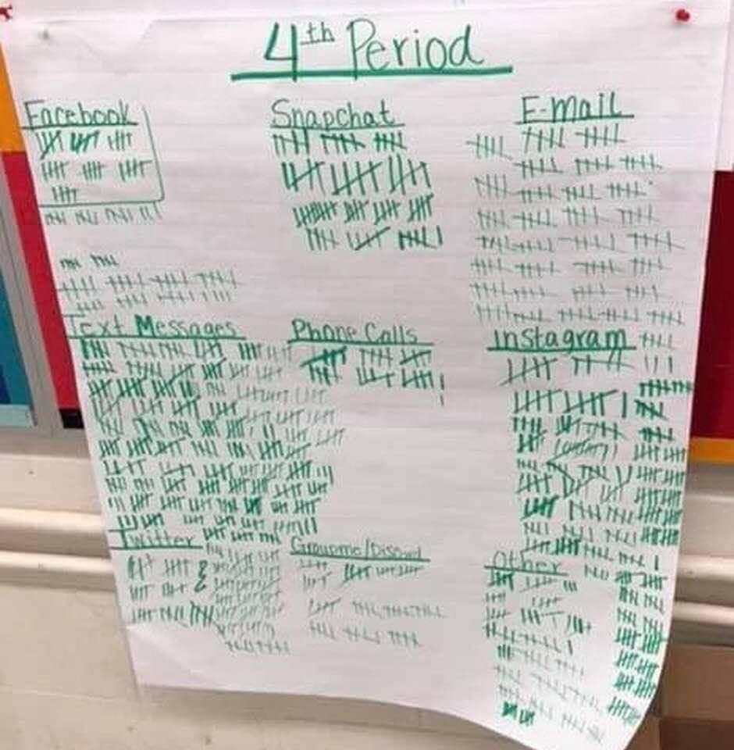
A teacher had her class write down every time they received a notification during class.
This is the result…
The phones are a distraction.

Slide 15
How can I get in serious trouble with my phone?
Taking pictures of teachers or students to put on social media for the purpose of bullying or mocking.
Filming a fight with your phone is a Level 2 offense.
Violation of Electronics and Technology Policy: Misuse of electronic or technological resources or devices, including, but not limited to, filming and/or posting images without the permission of the individual(s) being depicted, unauthorized access to the system network, creating or using the email or messaging account of another without permission to send communications.

Slide 16
Do not violate
Dress Code-
Students in violation of the dress code will not be allowed to enter class until it is remedied, i.e. pants sagging, inappropriate shirt. Any serious violations or violations that cannot be immediately rectified, i.e. skirt to short, blouse too revealing, will result in the student being sent to ISS.
Do NOT Bully-
There is a Zero Tolerance policy regarding bullying of any kind- verbal, physical, sexual, or cyber/electronic. Any instance of bullying in class will result in the immediate removal of the student by an administrator.
NO FIGHTING. PERIOD.

Slide 17
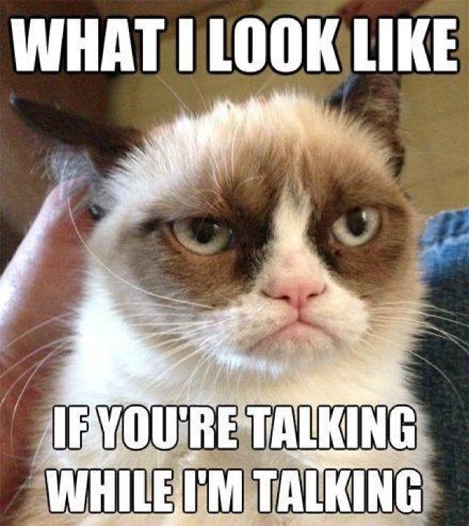
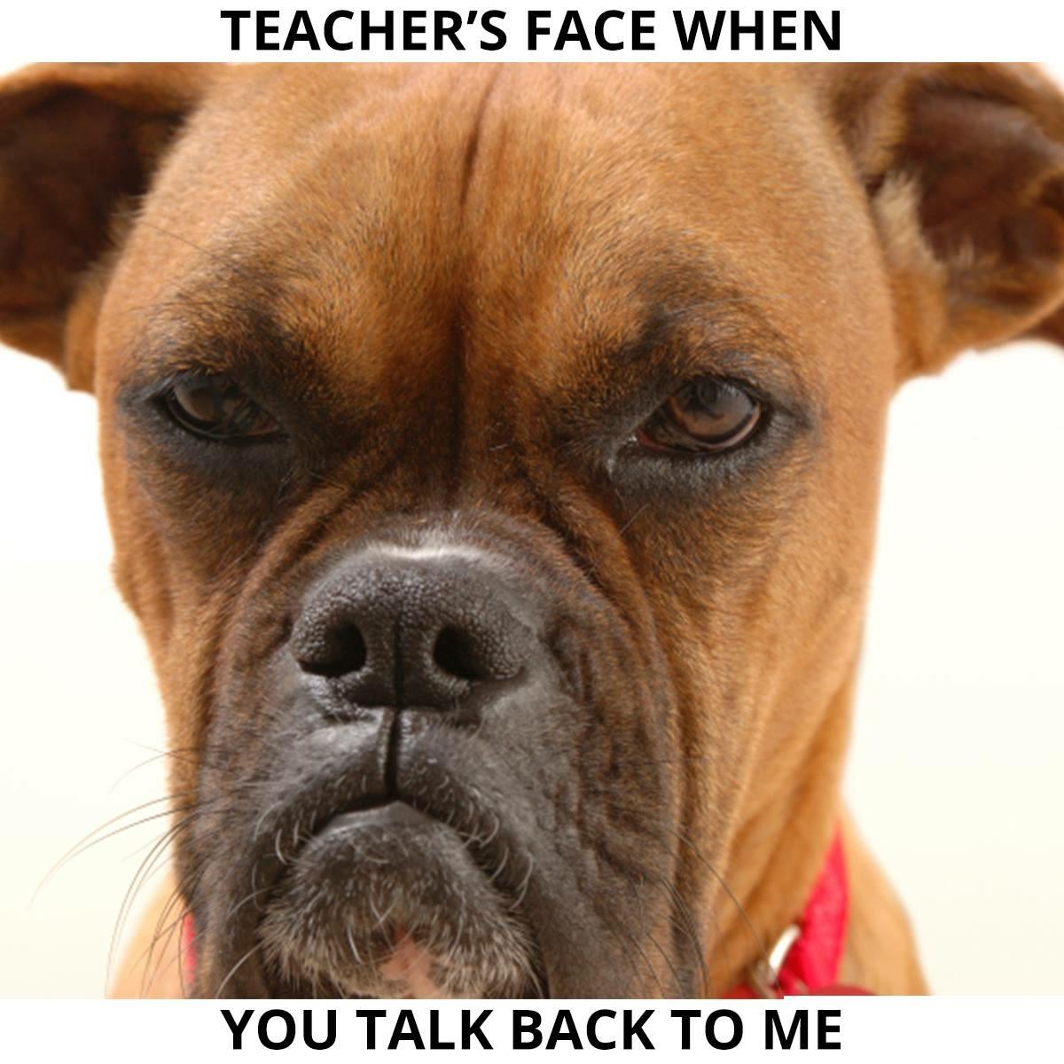
What is expected in the classroom?
R.E.S.P.E.C.T
The Classroom
The Task We Have
Each Other
Yourself

Slide 18
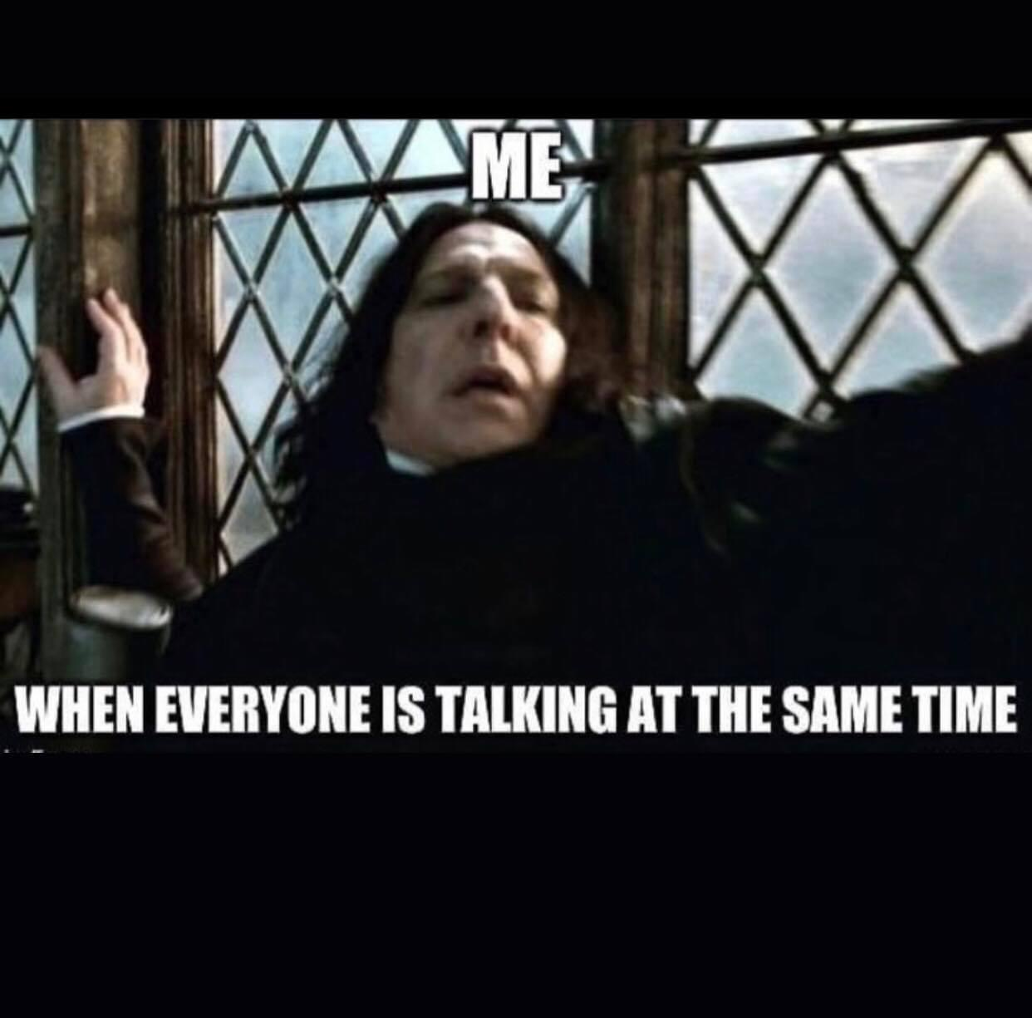
Please…. raise
your
hand

Slide 19
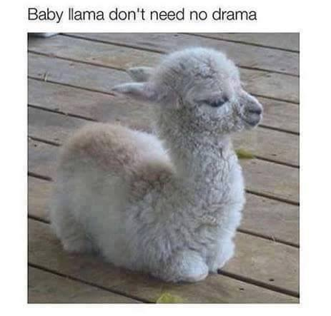
What type of discipline will there be?
It’s all up to you
1. Warning and/or Personal Conversation- YOU fix it
2. Phone call to parent…in class…with speaker phone- THEY fix it
3. Involve administration and paperwork- THEY fix it
Just….
DON’T

Slide 21
Cannot stress this enough

Slide 23
Why are you here?
To learn
To become a well-rounded, functional, critically thinking, educated member of society
To create and earn a foundation for your adult life
At NO time of this year should I care more for your education & your future than you
I will do my best to make this class fun, engaging, and to challenge you to THINK, but I cannot make you care. That is on YOU.
You are blessed to have a taxpayer funded “free” education- take FULL advantage of of it. EARN IT.
DEMAND to be taught well and to be helped when needed.
This is about YOU.

Slide 24
Have I
forgotten anything
??????

Slide 25
OH…
ONE LAST THING

Slide 26
